Slide 1
OGC-API EDR
An overview of the
Open Geospatial Consortium
Environmental Data Retrieval API

Slide 2
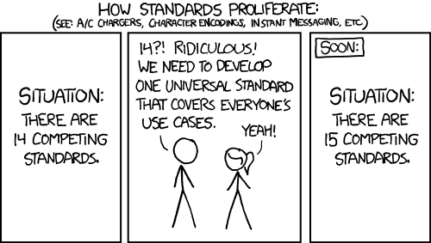
Why a new API?
Existing standards designed for remote access to datasets
Datasets often have domain and/or specific data structures
Information increasingly used by experts from other domains
Increasing requirement to `harden` API’s
Data sources updating more frequently and increasing in size
https://xkcd.com/927

Slide 3
Background
GeoTiff
PostgreSQL
NetCDF4
GML
NetCDF3
CREX
SHP
XML
Parquet
TSV*
AAIGrid
COG
HDF5
JSON*
GPKG
BUFR
XLS
CSV*
…and many more
Oracle
* many variations exist and additional information is required to understand a response in the format

Slide 4
OGC API EDR
Treats all data as information at a location and time
API authors decide how best to respond to the request
Doesn’t require for all the query patterns to be supported
Makes validating a request easier

Slide 5
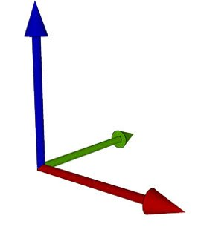
Data published as ‘Collections’
A Collection is a set of data that shares the same coordinate dimensions​
(i.e. the same units of space, height and time​)
All data in a collection must support the advertised format and coordinate transformations
An EDR collection behaves in much the same way as a database view
Abstracts the data storage approach from the data consumer
​​

Slide 6
Data discovery
id - Unique identifier for the Collection used in the URL
title - Name of the Collection
description - Brief text description of the Collection
links - URLs to information relevant to the Collection
extent - Spatio-Temporal bounds of the Collection
data_queries - Definition of the EDR queries supported by the Collection
parameter_names - Definition of the data parameters in the Collection

Slide 7
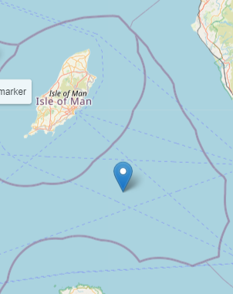
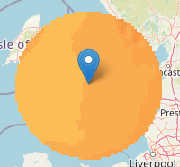
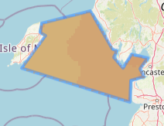
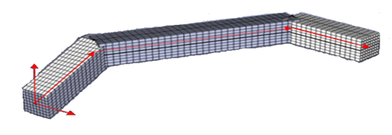
Query (Sampling) types
Position
Radius
Area
Cube
Trajectory
Corridor
Locations
Items

Slide 8
Parameter metadata
Description - A text label for the parameter
Units
  Label – A text label for the units
  Symbol
    value - The symbol used to represent the units
    type – Unique identifier for the units (ideally an URI to a common shared registry)
ObservedProperty
  id – Unique identifier for the parameter (ideally an URI to a common shared registry)
  Label – the formal name for the parameter
MeasurementType
  Method – The statistical process involved in deriving the value
  Period – The time period that the process occurs over (defined as an ISO8601 period)
"air_temperature": {
"type": "Parameter",
"description": "Air temperature is the bulk temperature of the air, not the surface (skin) temperature.",
"unit": {
"symbol": {
"type": "https://qudt.org/vocab/unit/K",
"value": "K"
},
"label": "Kelvin"
},
"observedProperty": {
"id": "http://vocab.nerc.ac.uk/standard_name/air_temperature/",
"label": "Air temperature"
}
}

Slide 9
Queries built on core query parameters
COORDS – Spatial coordinates defined as Well Known Text (WKT)
DATETIME* – time range based on the ISO8601 standards
Z* – vertical range selection
PARAMETER_NAMES – comma delimited list of the parameters
F – Data format to return the data in
CRS – Coordinate reference system to return the data in
(and also defines the CRS that COORDS values are defined in)
* only when data has the dimensional component

Slide 10
coords=POINT(X Y)&z=Z1
Position: extract data for a point location
(Can also be combined with datetime)
coords=POINT(X Y)
coords=POINT(X Y)&z=Z1,Z2,Z3,Z4
coords=POINT(X Y)&z=Z1/Z4

Slide 11
Position example
collections/surface/position?
coords=POINT(-4.042 53.847)
&datetime=2022-07-12T00:00Z/2022-07-12T01:00Z
&parameter-name=temperature
&crs=EPSG:4326
&f=CoverageJSON

Slide 12
Radius: extract data within a defined radius
(Can also be combined with datetime)
coords=POINT(x y)&within=r&within-units=u
coords=POINT(x y)&z=Z1&within=r&within-units=u
coords=POINT(x y)&z=Z1,Z2,Z3,Z4&within=r&within-units=u
coords=POINT(x y)&z=Z1/Z4&within=r&within-units=u

Slide 13
Radius example
/collections/surface/radius?
coords=POINT(-4.042 53.847)
&within=100
&within-units=km
&datetime=2022-07-12T00:00Z/2022-07-12T01:00Z
&parameter-name=temperature
&crs=EPSG:4326
&f=CoverageJSON

Slide 14
Area: extract data for a 2D geospatial domain
(Can also be combined with datetime)
coords= POLYGON(x1 y1, x2 y2, x3 y3, x4 y4, x1 y1))
coords= POLYGON(x1 y1, x2 y2, x3 y3, x4 y4, x1 y1))&z=Z1
coords= POLYGON(x1 y1, x2 y2, x3 y3, x4 y4, x1 y1))&z=Z1,Z2,Z3,Z4
coords= POLYGON(x1 y1, x2 y2, x3 y3, x4 y4, x1 y1))&z=Z1/Z4

Slide 15
Area example
collections/surface/area?
coords=POLYGON((-4.267 54.427,-4.359 54.080,-3.753 53.806,
-3.014 53.992,-4.267 54.427))
&datetime=2022-07-12T00:00Z/2022-07-12T01:00Z
&parameter-name=temperature
&crs=EPSG:4326
&f=CoverageJSON

Slide 16
Trajectory: extracts data along a defined path
coords=LINESTRING(X1 Y1 , … Xn Yn )
coords=LINESTRING(X1 Y1 , … Xn Yn )
(can be combined with the z and datetime)

Slide 17
Trajectory example
collections/surface/trajectory?
LINESTRING(-4.074 53.754,-3.225 53.935,-4.065 53.956,
-4.451 54.144,-4.241 54.314)
&datetime=2022-07-12T00:00Z/2022-07-12T01:00Z
&parameter-name=temperature
&crs=EPSG:4326
&f=CoverageJSON

Slide 18
Trajectories can have more complex height and time coordinates
coords=LINESTRINGM(X1 Y1 T1, … Xn Yn Tn )
(can be combined with the z query parameter)
coords=LINESTRINGZ(X1 Y1 Z1, … Xn Yn Zn )
(can be combined with the datetime query parameter)
coords=LINESTRINGZM(X1 Y1 Z1 T1, … Xn Yn Zn Tn )

Slide 19
Trajectory varying time example
collections/surface/trajectory?
LINESTRINGM(-4.074 53.754 1657584000,-3.225 53.935 1657587600,
-4.065 53.956 1657591200,-4.451 54.144 1657594800,
-4.241 54.314 1657598400)
&parameter-name=temperature
&crs=EPSG:4326
&f=CoverageJSON

Slide 20

Corridor
The same capabilities as the trajectory query but with extra values to define a corridor
  corridor-width
  width-units
  corridor-height
  height-units

Slide 21
Corridor example
collections/height-levels/corridor?
LINESTRINGZM(-4.065 53.754 5.0 1657584000,-3.186 53.943 10.0 1657587600,-4.082 53.941 30.0 1657591200,-4.443 54.137 20.0 1657594800)
&corridor-width=2
&width-units=m
&corridor-height=1
&height-units=m
&parameter-name=temperature
&crs=EPSG:4326
&f=CoverageJSON

Slide 22
Cube: extracts data for a 3D domain geospatial domain
(Can also be combined with datetime)
bbox=minX,minY,maxX,maxY&z=Z1/Z2

Slide 23
Cube example
collections/height-levels/cube?
bbox=-3.085 53.723,-4.236 54.293
&z=5.0/30.0
&datetime=2022-07-12T00:00Z/2022-07-12T01:00Z
&parameter-name=temperature
&crs=EPSG:4326
&f=CoverageJSON

Slide 24
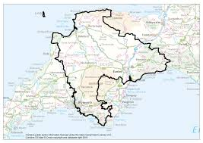
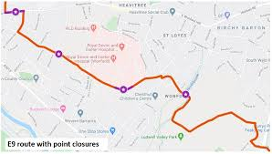

Locations
Named location identifiers for predefined Geospatial coordinates
API provides capability to get list of identifiers and the definition of the coordinates they represent
Supports the other common query parameters i.e. parameter-name, datetime, f

Slide 25







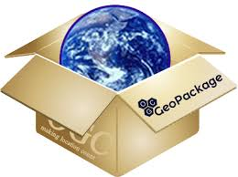


Items
There will always be a need to return predefined data objects
/items lists the available data objects (each with a unique identifier id)
/items lists can be filtered by bbox and datetime (with paging support)
Objects requested by their identifier (/items/{identifier_id})

Slide 26
EDR is still evolving
EDR v1.1
  Adds support for custom dimensions
    Allows definition of data axes other than space and time
  Adds support for HTTP POST
EDR v1.2
  Will add support for Publish/Subscribe data
  ….

Slide 27
Any questions?
Further information is available at:
https://ogcapi.ogc.org/edr/
https://github.com/opengeospatial/ogcapi-environmental-data-retrieval

