Slide 1
Understanding the Uses & VALUE of Marine Data
OECD survey of marine data archive and management centre users
Claire Jolly, Head of Unit
OECD Science, Technology and Innovation Directorate
Claire.Jolly@oecd.org
MEDIN Open Meeting 26th April 2023
Enhancing the national framework for sharing UK marine data.

Slide 2
Can we demonstrate how marine data can improve efficiency, productivity in different socio-economic activities?
Some market-uses are already well identified
Value chains map the relationship between data production, data processing, generation of data products, and the usage by different user groups
Understanding better value chains contributes to valuation
Direct economic benefits
Indirect economic benefits
Societal benefits
See OECD (2019), Rethinking Innovation for a Sustainable Ocean Economy, OECD Publishing, Paris.
2

Slide 3
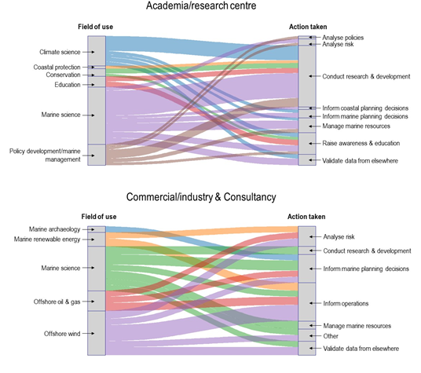
Exploring the Value Chains of Public Marine Data…
The value chain approach:
Identification / types of marine data
Characterization of different user communities
Exploration of pathways through which marine data are used and transformed into actionable information
Laying the foundations for measuring value - See paper: https://doi.org/10.1787/d8bbdcfa-en
A case in point: the successful case study on UK data repositories & value chains: Cooperation between the OECD, the UK's Marine Environmental Data and Information Network (MEDIN) ands its partnering Data Archive Centres (DACs), and the Global Ocean Observing System (GOOS) with key achievements:

Slide 4
Main advantages to data & archive centre (DACs) of participating in this survey
Comparable information on marine data use and the benefits across DACs and countries
Closing knowledge gaps surrounding marine data reuses
Feedback from marine data users of multiple DACs
Learning more on what works (and what doesn’t) from users and other DACs

Slide 5
Definitions used in the OECD survey
Ocean data: Physical, biochemical and biological properties
i.e. key variables associated with ocean observations
Marine data: All of ocean data plus hydrographic survey data, human activities (e.g. data on fisheries, cables etc.), archaeology etc.
The Variables used in the OECD survey are all based on the standard SeaDataNet’s controlled list of parameters (P08)

Slide 6
Links between sectors, fields and actions: much information collected along the way

Slide 7
e.g. Commercial/industry and consultancy – from field of uses to actions

Slide 8
e.g. Government and maritime authority – from field of use to actions

Slide 9
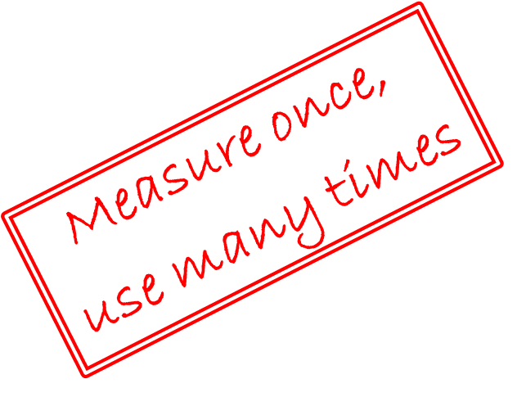
Benefits of UK MEDIN – OECD collaboration
For UK MEDIN
Evidence
Validation (who, why)
New (fields of use, actions)
Exposure
International
Socio-economic
Other, 6%
Link to data, 13%
Download raw data, 29%
Download data
products, 24%
Search for data, 28%
For the project
Skills, knowledge
Broader scope
Robust analysis

Slide 10
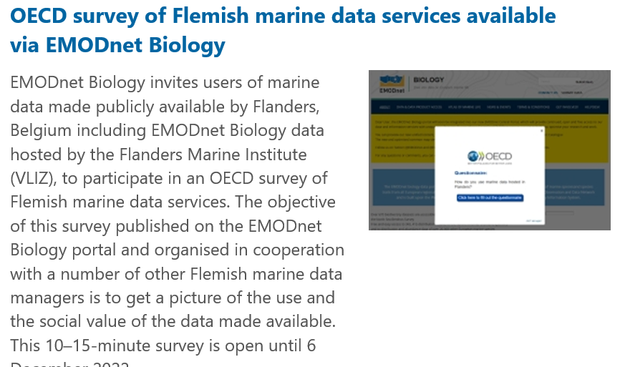
Two ongoing case studies
Belgium / Flanders
Surveys in English/Flemish
Advertised on data repositories and social media by Flemish colleagues (efficient!)
Just closed, already very interesting results on very different types of users (app developers)
Portugal
Surveys in English/ Portuguese
Advertised on social media by videos
…And ongoing research on drafting methods for marine data valuation
Joint GOOS-Univ. of New Mexico-OECD work: develop an experimental and generic model for valuation to be applicable to various sectors identified in the value chain exercise and beyond

Slide 11
Linking all this to the big picture
Ocean environment & ocean economy evolving rapidly
Need more data from more places, but also different types of data, to respond to policy demands (timeseries on biodiversity, seabed composition…)
Not just funding issues but organizational ones
Ocean foresight with “the ocean economy in 2045”
The ongoing OECD project aims to improve understanding of how the ocean economy might evolve in the coming decades
It will provide new evidence, new economic projections and actionable recommendations to policymakers on how sustainable management of the ocean economy might be strengthened.
OECD results will feed evidence and policy recommendations in advance of the next UN Ocean Conference to be held in Nice, France (June 2025).

